Slide 1
SUMMER R&D INTERNSHIPS 2018 EECE, UTH
VIKTORIA l.BILIOURI

Slide 2
SPICE-based SSTA Analysis for very small circuits
VIKTORIA l.BILIOURI

Slide 3
SPICE-based SSTA Analysis for very small circuits
Obtain necessary knowledge
Design simple circuits
Change Global and Local Parameters of transistors (W, l, Tox, Vτ)
Monte Carlo Analysis
Simulate
Examine the results, delays
Statistical analysis of the results - Matlab

Slide 4
Presentation Timeline – 3 Months

Slide 5
Presentation Timeline – 3 Months
16-06
Theory
SSTA, MonteCarlo,
Process Variation etc.

Slide 6
Presentation Timeline – 3 Months
Implementation
Curcuit Design & Analysis
16-06
16-07
Theory
SSTA, MonteCarlo,
Process Variation etc.

Slide 7
Presentation Timeline – 3 Months
Implementation
Curcuit Design & Analysis
16-06
16-09
16-07
Theory
SSTA, MonteCarlo,
Process Variation etc.
Statistic Analysis- Matlab

Slide 8
Presentation Timeline – 3 Months
Implementation
Curcuit Design & Analysis
Final Presentation
16-06
16-09
16-07
10-10
Theory
SSTA, MonteCarlo,
Process Variation etc.
Statistic Analysis- Matlab

Slide 9
Statistical Static Timing Analysis - SSTA
Analysis algorithm for the design of digital circuit
Examine the worst case
Gives a distribution of possible circuit outcomes (instead of conventional STA)
Methods:
Path-based Algorithm
Block-based Alogrithm

Slide 10
Process Variation
Naturally occuring variation in the attributes of transistors
Systematic Variation
Random Variation
Inter-die
Intra-die
Global Variation
Affect equally all the transistors of a circuit
Local Variation
Each transistor is affected differently
Ex: Oxide thickness, Dopant concentration, W, L

Slide 11
Process Corners
Design-of-Experiments technique
Variation of fabrication parameters of an integrated circuit design to a semiconductor wafer
Corner-lot analysis
most effective in digital electronics
Direct effect of process variation on the speed of transistor switching
Types
FEOL (Front end of line) : typical, fast, slow -> TT, FF, SS (=even corners)
FS, SF (=skewed corners)
BEOL : Process, Voltage, Temperature Variation

Slide 12
Monte Carlo Method
Rely on repeated random sampling
Simulation – Use a generator which produces random numbers
Named after a famous Casino in Monaco
General method:
Define a domain of possible inputs
Generate inputs randomly from a probability distribution over the domain
Perform a deterministic computation on the outputs
Aggregate the results

Slide 13
SPICE - (Simulation Program with Integrated Circuit Emphasis)
Open Source Analog Electronic Circuit Simulator
Purpose
check the integrity of circuit designs
predict circuit behavior
Developed at the Electronics Research Laboratory of the University of California, Berkeley
PSPICE, NGSPICE, LTSPICE, HSPICE, etc.

Slide 14
FinFET
Multi-gate MOSFET (Metal Oxide Semiconductor Field Effect Transistor)
Incorporates more than one gate in one device
Body wrapped over a thin silicon film
Need of smaller and faster devices => Need of FinFET
Bulk FinFET - SOI FinFET
Important parameters : L, TFIN, TOX, VTO

Slide 15
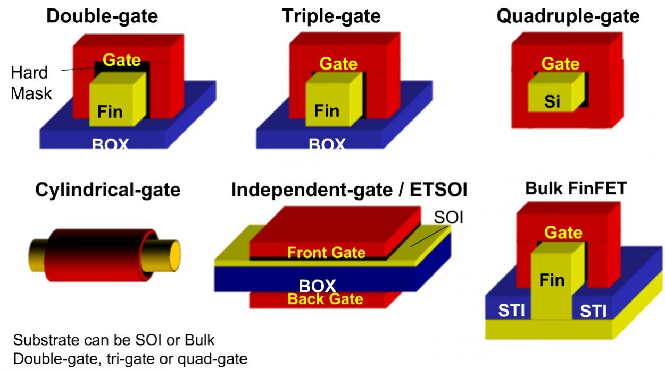
FinFET Types

Slide 16
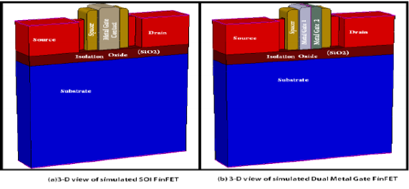
FinFET Costruction

Slide 17
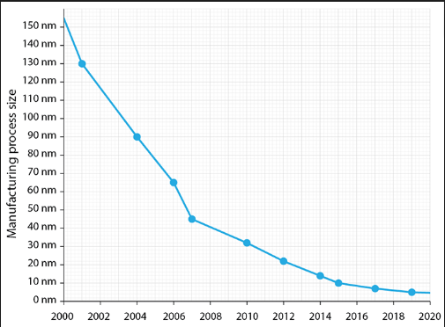
Evolution of Transistor
Next Generetion -> Nanowire FET

Slide 18
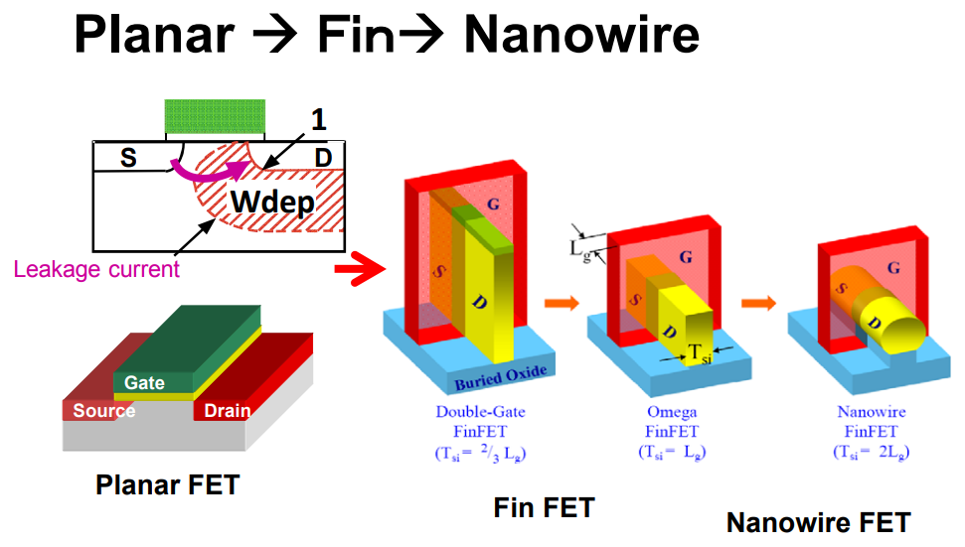
Comparison of Transistors

Slide 19
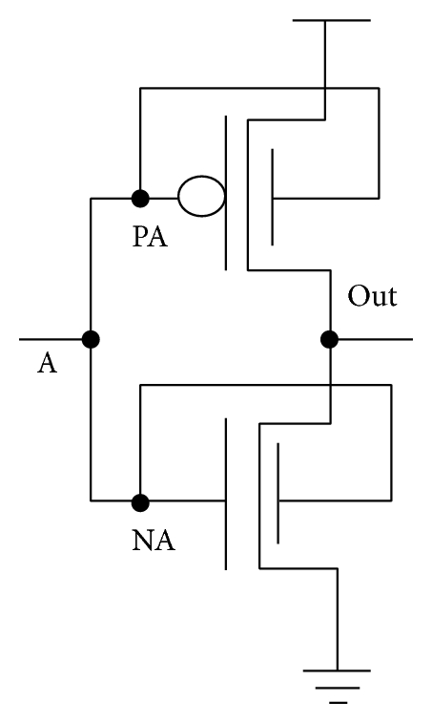
FinFET Inverters Circuit
PB
OutA
B
NB

Slide 20
Monte Carlo Simulation of FinFET Inverter
Simulation Parameters
Finfet parameters
Vin = 1.0V, rise time 0.01 ps
Vdd = 1.0V
Transient Analysis 20ps
L = 30nm
Fin Thickness(TFIN) = 15nm
Number of fins(NFIN) = 10
L variation = 10% x (30nm)
TFIN variation = 10% x (15nm)
NFIN variation = 20% x 10

Slide 21
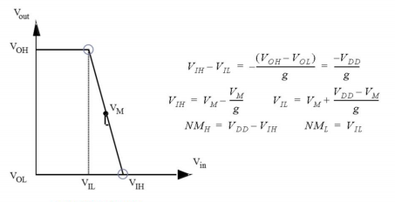
Inverter Circuit Analysis
VIL : Vin = 0
VIH : Vin -> high
VOL : Vout =0
VOH : Vout -> high

Slide 22
Inertial Delay – Rise / Fall Time Delay
Inertial Delay
Time between the point where:
Vin is VIH/2
Vout is VOH/2
Rise Time Delay
Time distance between 10% and 90% of Vout -> Rise
Fall Time Delay
Time distance between 90% and 10% of Vout -> Fall

Slide 23
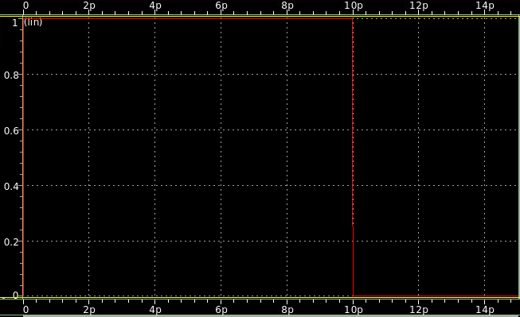
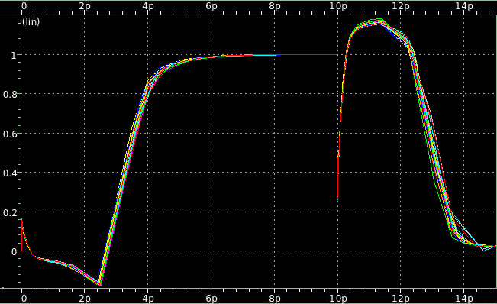
Time - Vin
Time - Vout
Monte Carlo
Parameter L

Slide 24
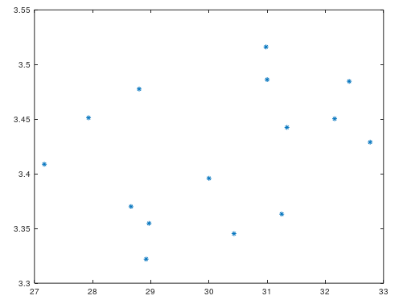
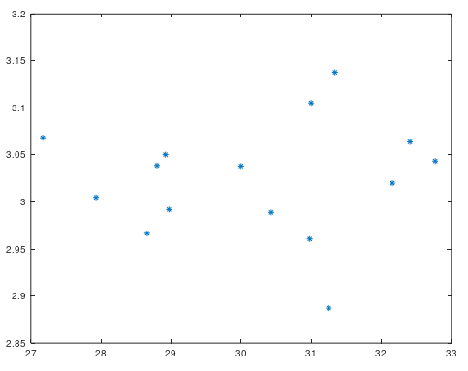
Inertial Delay Results - Matlab
(Rise) Inertial Delay (ns – ps)
(Fall) Inertial Delay (ns – ps)

Slide 25
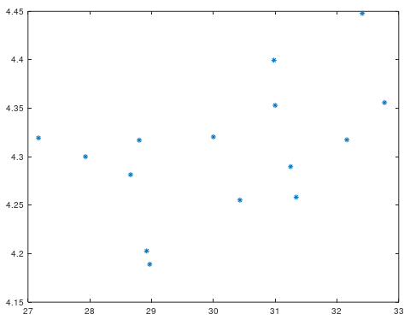
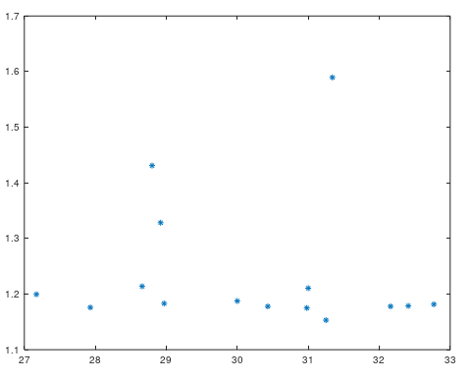
Rise/ Fall Time Delay - Matlab
Rise Time Delay(10%-90%) (ns – ps)
Fall Time Delay(10%-90%) (ns – ps)

Slide 26
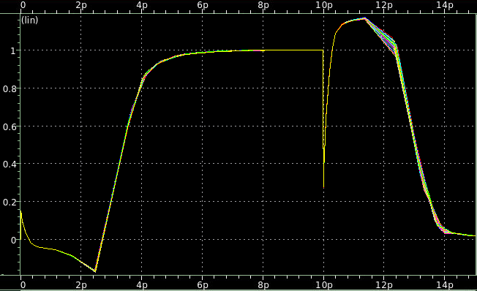
Time - Vin
Time - Vout
Monte Carlo
Parameter TFIN

Slide 27
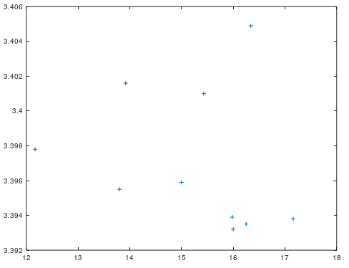
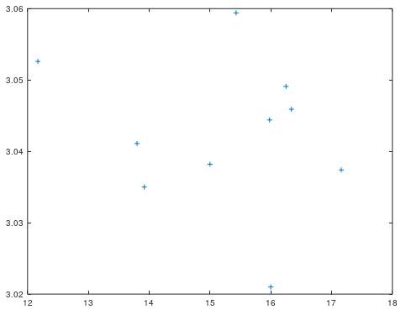
Inertial Delay Results - Matlab
(Rise) Inertial Delay(ns – ps)
(Fall) Inertial Delay(ns – ps)

Slide 28
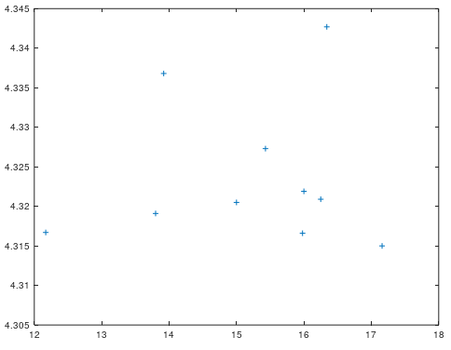
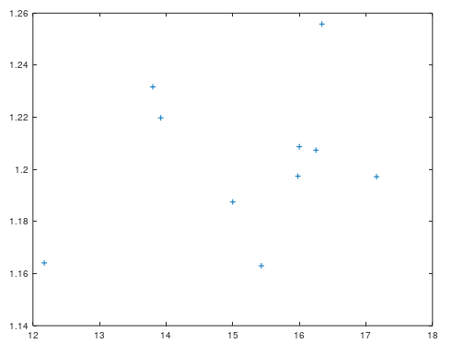
Rise/ Fall Time Delay - Matlab
Rise Time Delay(10%-90%) (ns – ps)
Fall Time Delay(10%-90%) (ns – ps)

Slide 29
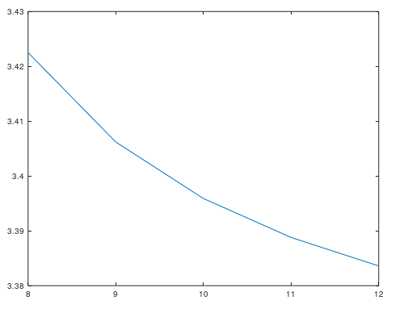
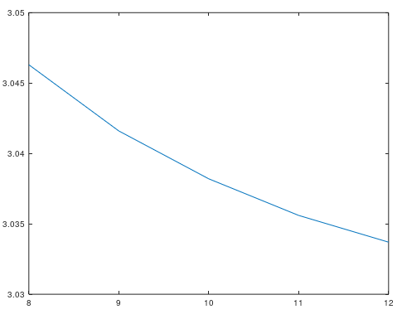
Inertial Delay Results(NFIN) – Matlab
(Rise) Inertial Delay
(Fall) Inertial Delay

Slide 30
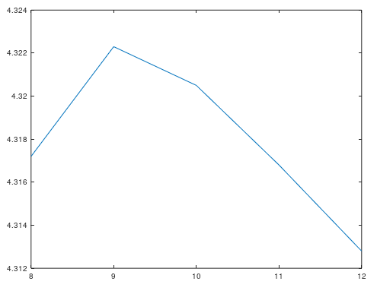
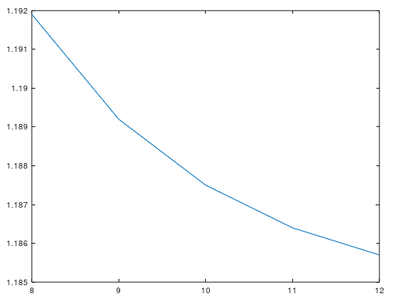
Rise/ Fall Time Delay(NFIN) - Matlab
Rise Time Delay(10%-90%)
Fall Time Delay(10%-90%)

Slide 31
End of Presentation

